Slide 1
Transparency in Cost –
Anthem Digital Tools
Jan 2023
mod=main;
data=API;
filter=;
v=1.0 – 1001/12/22;

Slide 2
Context
The Transparency in Coverage and Cost requirements (effective for 2023) mandate display of health care cost information through our online tool
        Specifically, display health care costs based on the care provider’s fee schedules for 480 CMS-defined shoppable CPT procedure codes, 4 DRG codes and 9 HCPCS codes
Anthem.com and Sydney already supported the display of pricing information for 1700+ grouped procedures (e.g., Arthroscopic Knee Repair) based on historical claims
For 1/1/23, members will see an additional option within the dropdown menu of search results on anthem.com to search by certain “Medical Codes” (CPT, DRG & HCPCS) and view estimated member liability
Sydney Health mobile will gain the same additional search options in Q2 2023
* 53% adoption average in National Accounts with roughly 1/3 of members returning each month

Slide 3
Procedure Based
Cost Experience

Slide 4
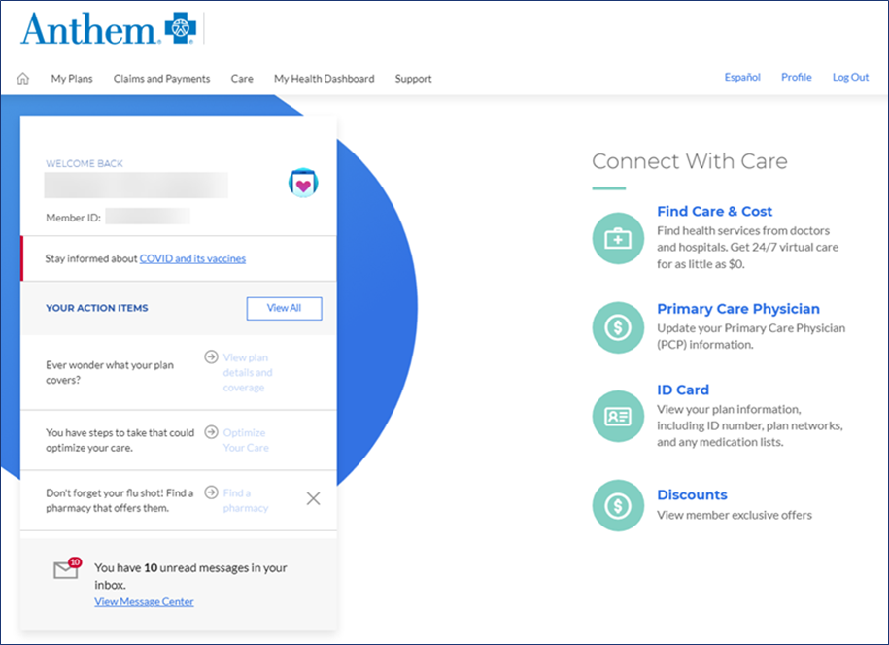

Slide 5
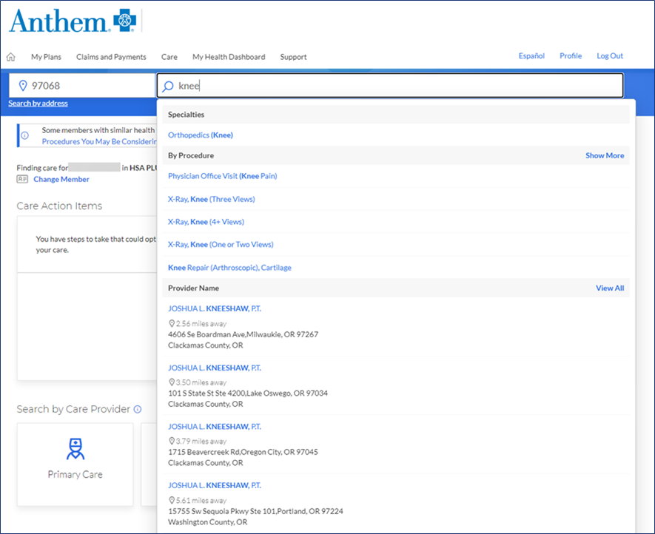
Anthem.com / Sydney mobile have, for many years, supported the display of pricing information for grouped procedures (e.g., Arthroscopic Knee Repair) based on historical claims.
We believe members will continue to want a full bundled cost associated with their full episode of care.

Slide 6
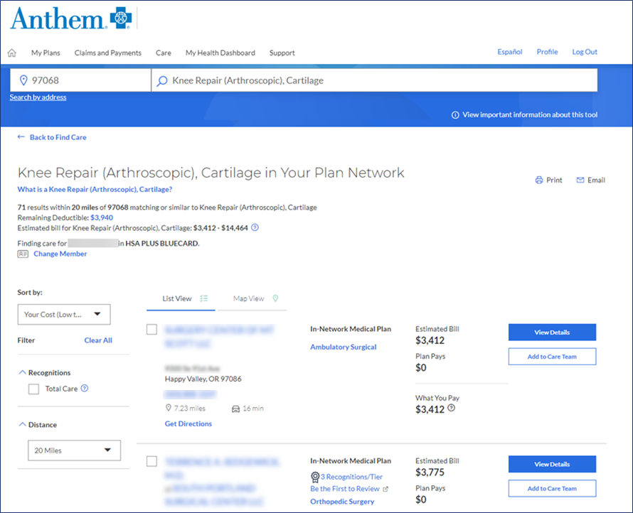
Cost searches include pricing on hundreds of NCCT* procedures, or episodes of care, based on historical pricing and member benefits
*NCCT = BCBS AXIS/NCCT Cost & Quality that includes cost range for total episode of care,. This includes the facility, professional, and ancillary services provided during an admission or outpatient visit (based on historical rates)

Slide 7
New Medical Code Search

Slide 8
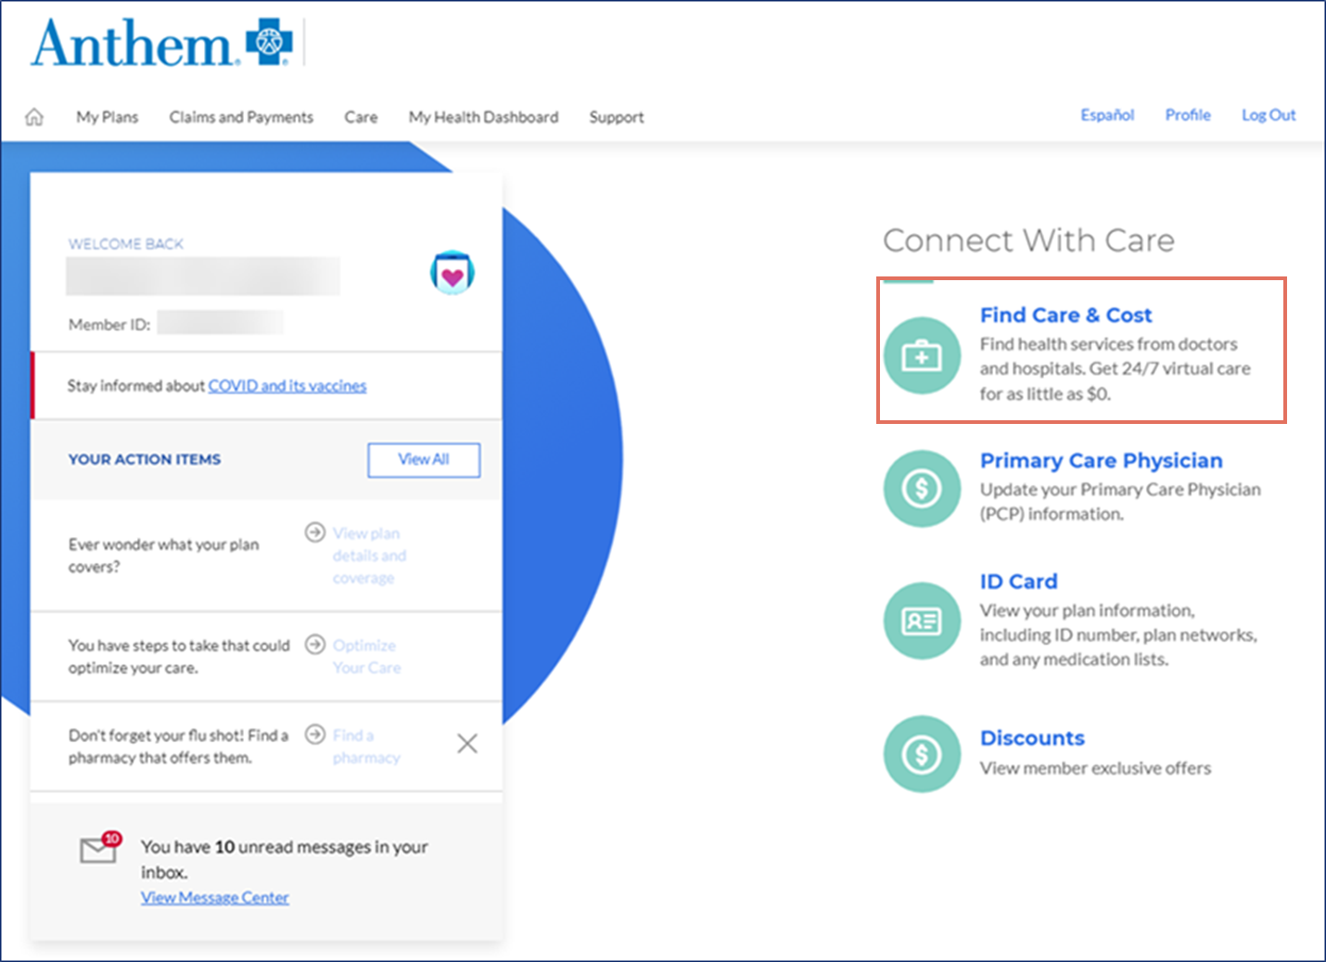
Added Experience for 2023 – Use Existing Find Care & Cost Tool
Use the existing Find Care tool already available to members for provider specialty and cost searches

Slide 9
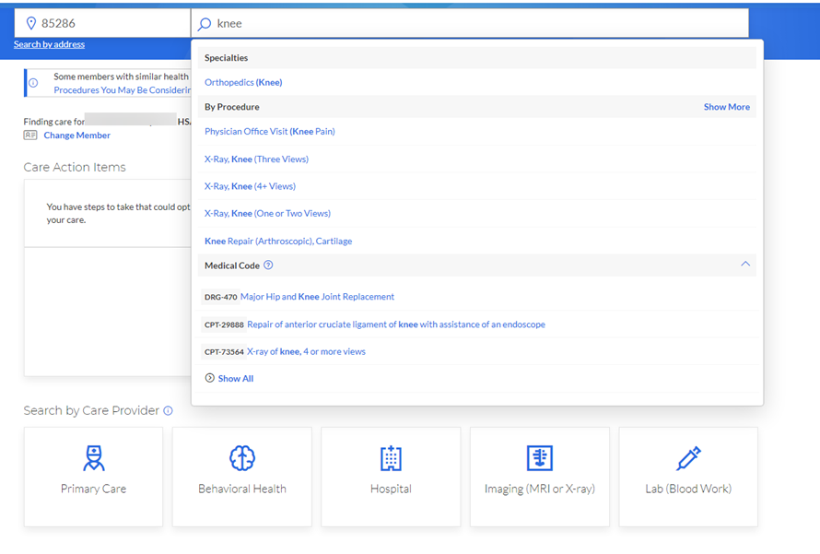
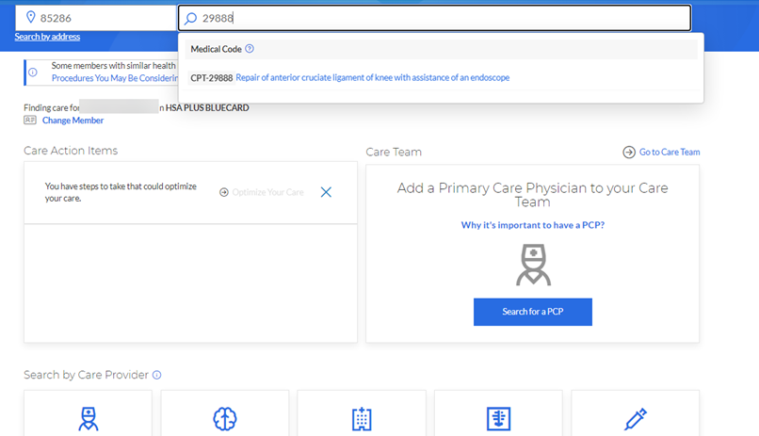
Added Experience for 2023 – Medical Code Search
Medical Code is a new option for cost searches. This includes certain CPT, DRG & HCPCS codes:
1
Search via text to reveal the Medical Code section at the bottom list of search options. Click Medical Code to display matching codes
1
2
2
Search by code to see the matching Medical Code

Slide 10
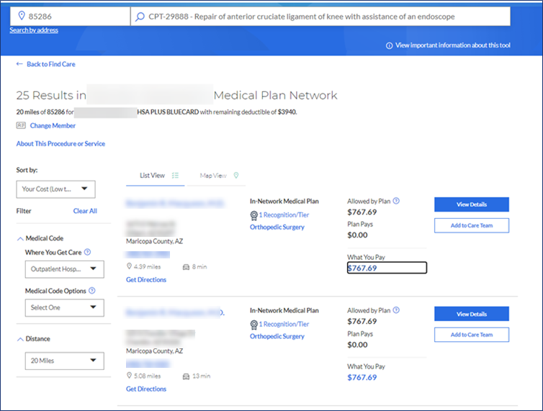
Added Experience for 2023 – Medical Code Search Results
Members will see all network providers and contracted costs. What You Pay displays member cost after benefits are applied.
Can filter by:
Where You Get Care¹
Medical Code Options – modifiers²
Members will also be notified at time of search for things like Service Limits, Preapproval Requirements, etc.
¹”Where you can get care” = place of service
²“Medical Code Options” (e.g., Technical Component vs Professional Component)

Slide 11
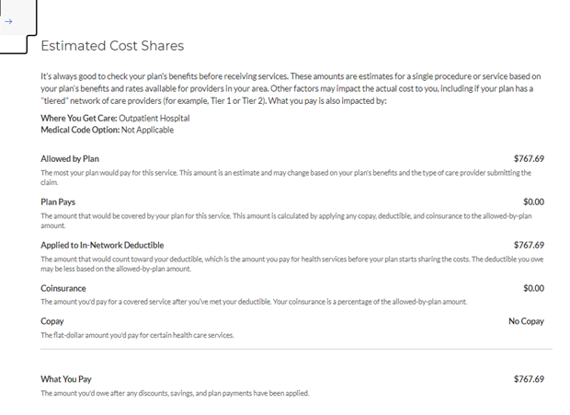
Added Experience for 2023 – Estimated Cost Shares
2
Additional information on estimated cost shares is available through “What you Pay” link
1
“What You Pay” link will navigate member to a slide-out with the details of the medical code cost
2
Estimated Cost Shares slide-out displays breakdown of estimated costs based on member benefits
1

Slide 12
Timelines
Jan 1, 2023
Find Care searchable by ~500 CMS-defined medical codes on anthem.com
Sorting and filtering available by cost and distance, as well as Distance and Medical Code Filters (to include selection of Place of Service and modifiers¹).
Spanish translation available
Early 2023
Expanding filters to include things like Provider Type, Tier 1, Medical Group, PCP, Blue Distinctions, etc. will be included
Sorting (ascending/descending) by provider will be offered
Add CMS-defined medical code search to Sydney mobile app
By end of 2023
Expansion of searchable procedure codes, per regulations
¹Technical Component vs Professional Component

